Slide 1
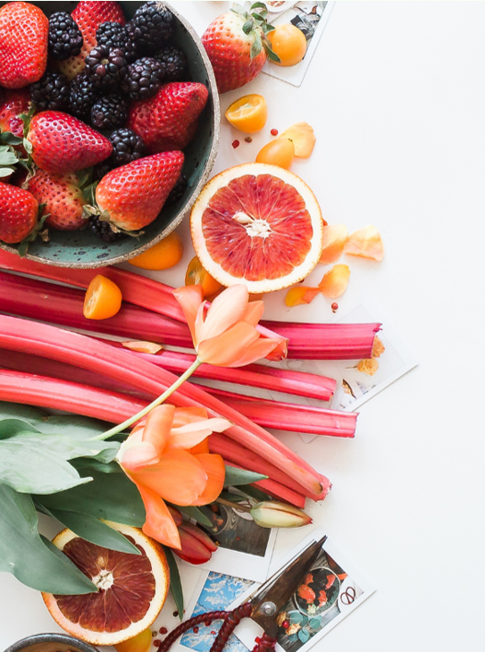
NutriVis –
Visualising Nutritional Profiles of Foods
Our Team
⬖Steph Adey
⬗Sonal Bhosle
⬘Liwei Jiang
⬙Aryan Linga

Slide 2

Notes:
Purpose - Endeavor to enhance nutritional literacy by providing a visually comparative analysis that empowers individuals to make informed dietary choices.
Planning and Research – Explored various websites and finally agreed on the dataset from data world which we then tried to understand and cleanse.
Coding Design – we then looked at the different ways of coding and making the dataset more meaningful.
Explore visualization tools – Various new libraries were explored, and Bokeh was utilized for data visualization.
Output – The project and coding output will be showcased in the next slides.

Slide 3
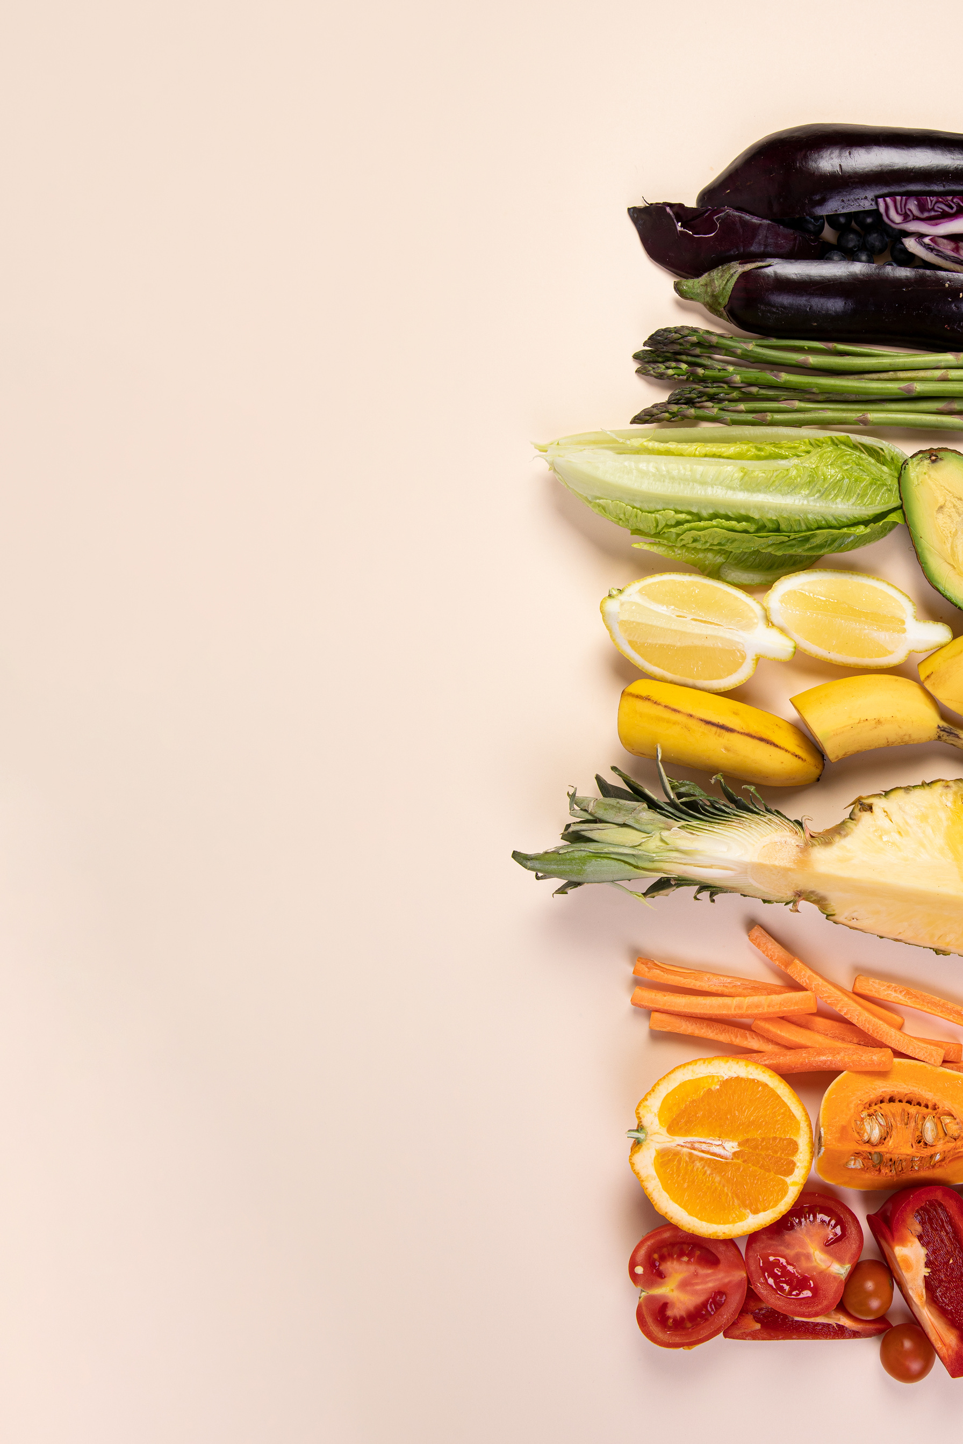
Data
•Original data consists of 8787 items of food extracted (E) from data.world (https://data.world/awram/food-nutritional-values/workspace/file?filename=ABBREV.xlsx)
•
•Transformation (T) of the original data was performed based on the descriptions, the food items have been categorised into 8 common categories: Dairy, Fruits, Grains, Meats, Nuts & Seeds, Seafood, Vegetables, and others.
•A final sample of 700 items were selected which consists of 100 for each category(sorted by values in descending order) above except for the broad category “others”.
•
•Both the original dataset and the final sample of 700 food items are then exported as csv and json files and loaded (L) to MongoDB database to store and/or use when needed before the analyses are performed.

Slide 4

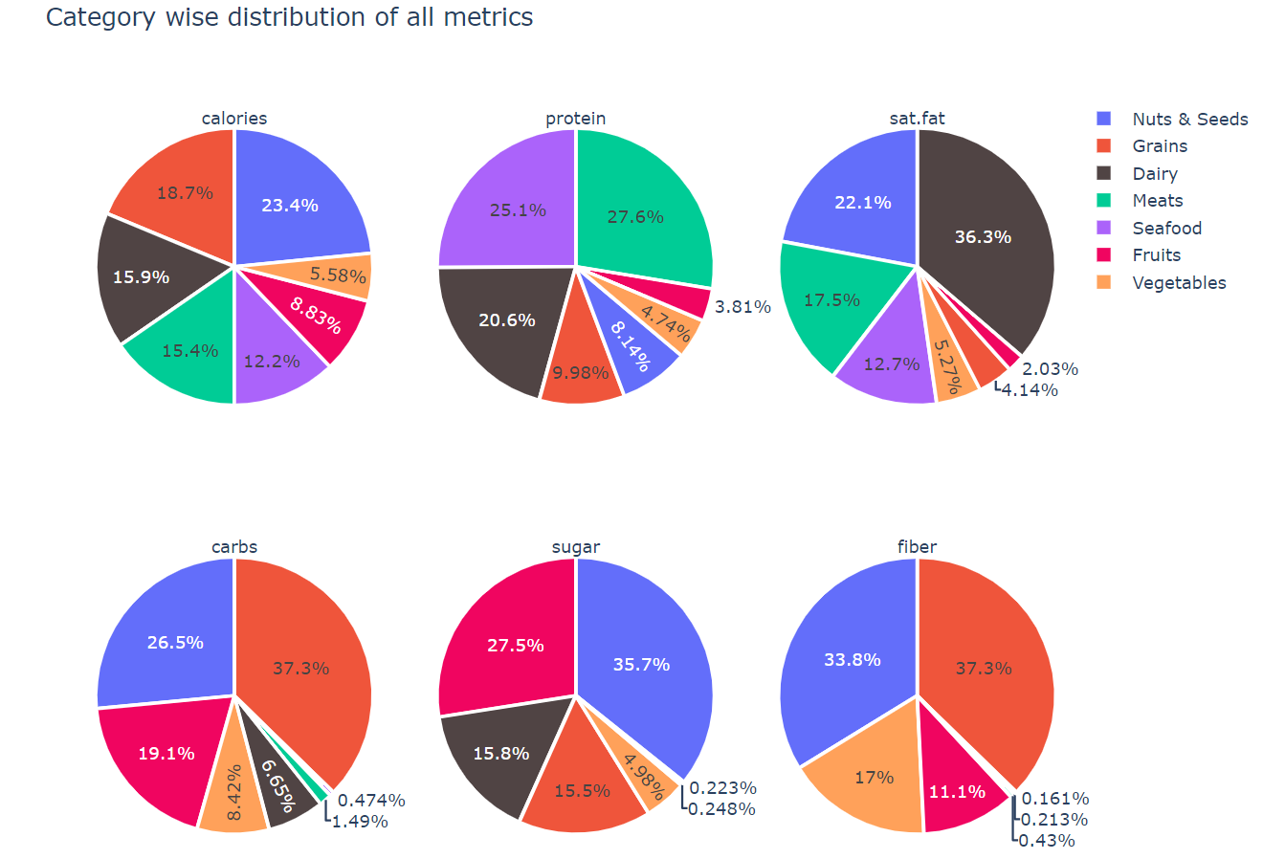
Average nutrition values by category

Slide 5
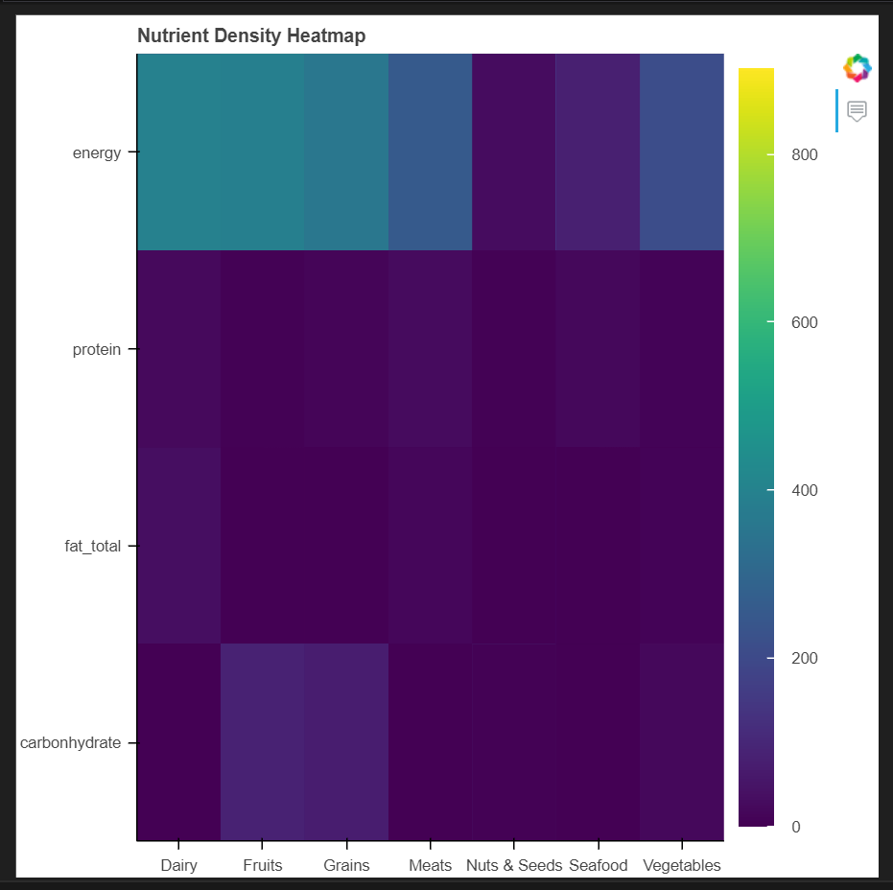
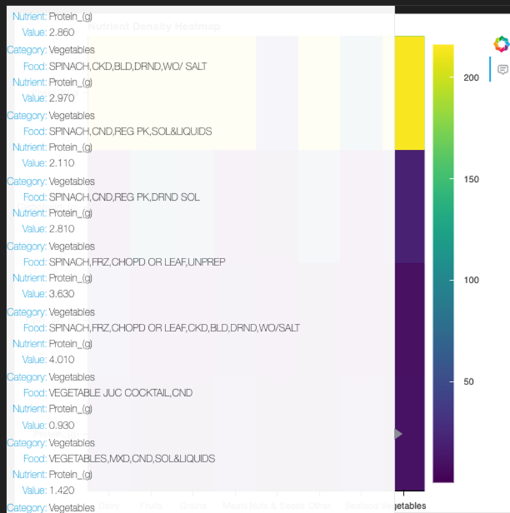
Nutrient Density Heatmap

Slide 6
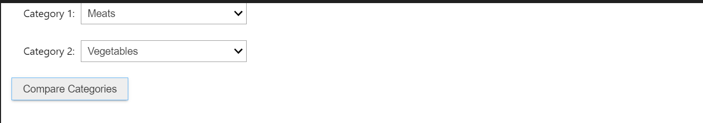
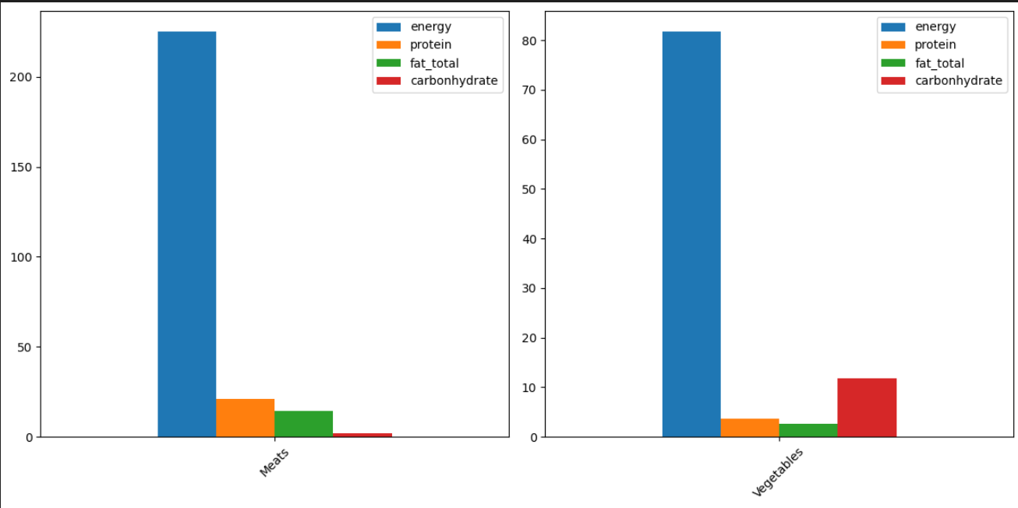
Comparison of nutrition values between two selected categories

Slide 7
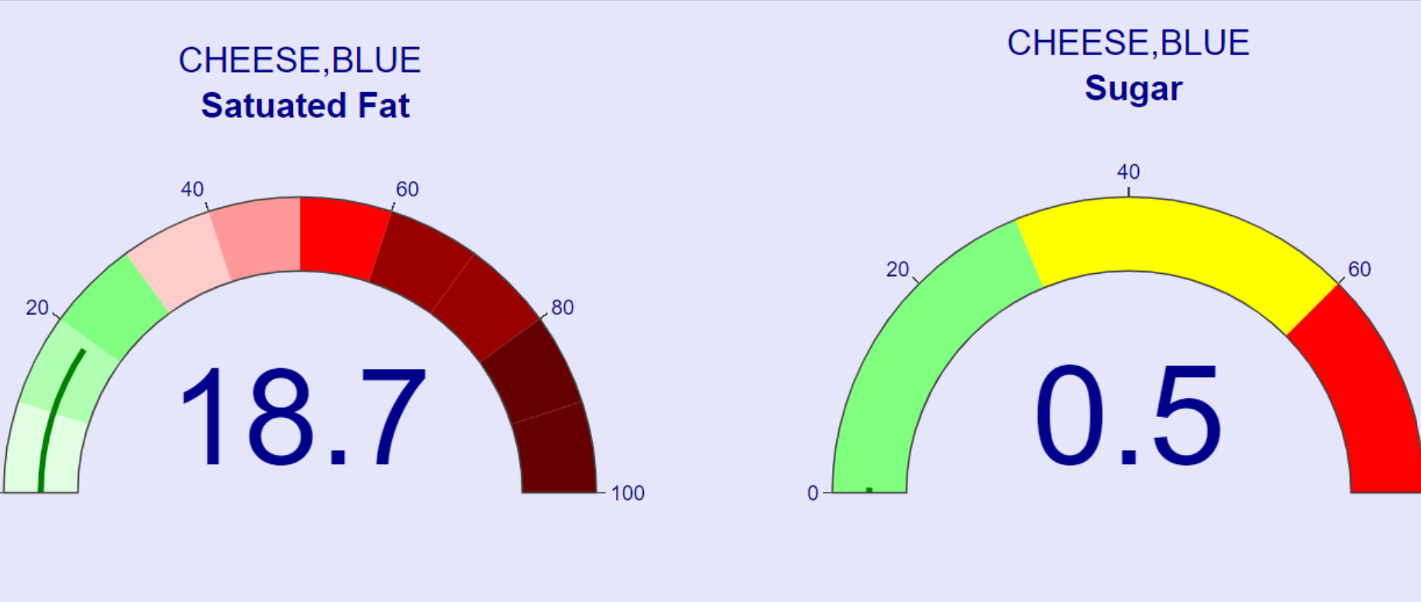
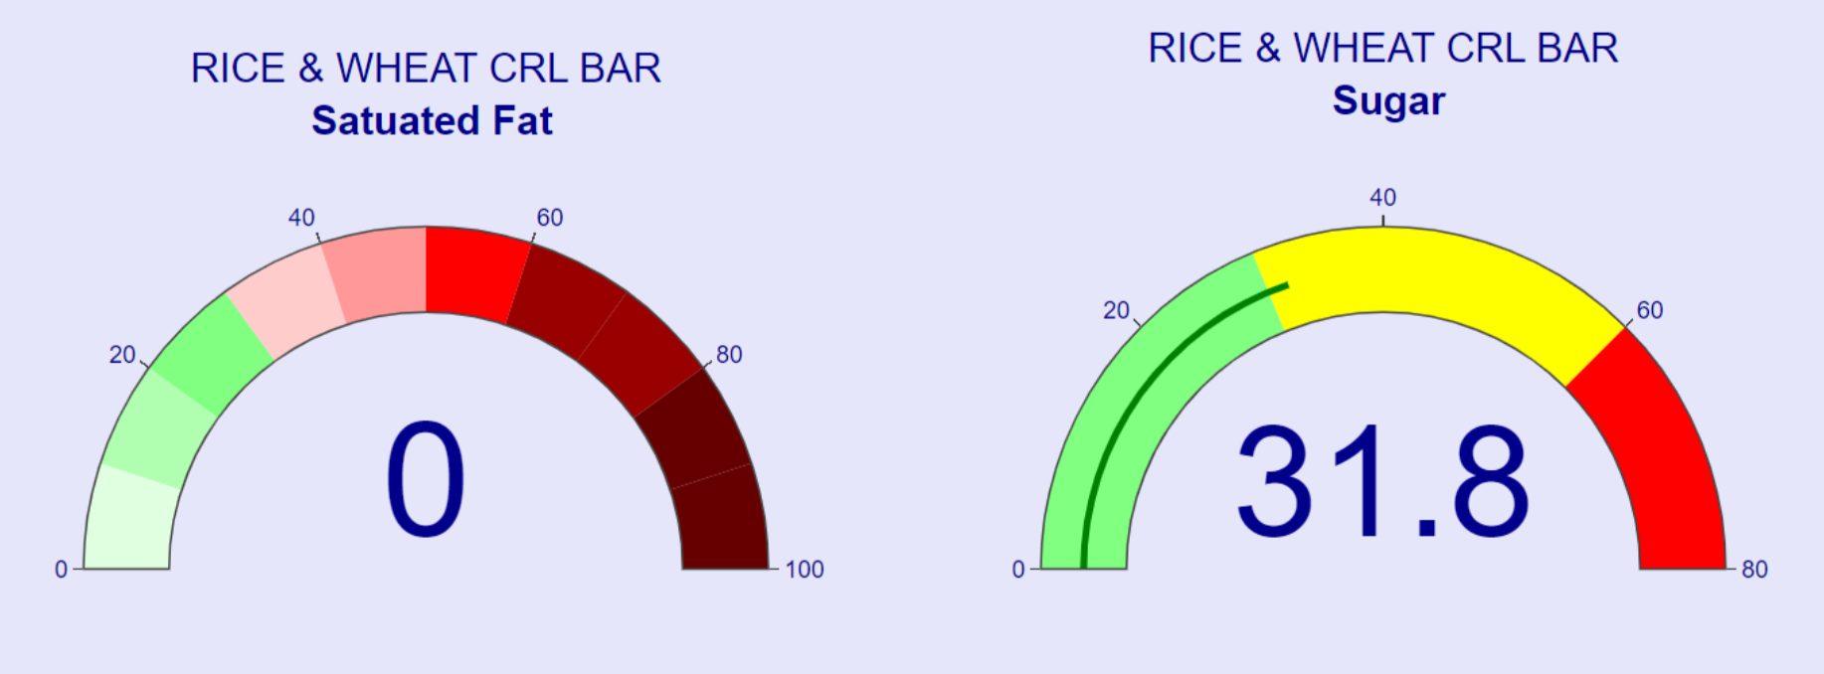
Gauge charts

Slide 8
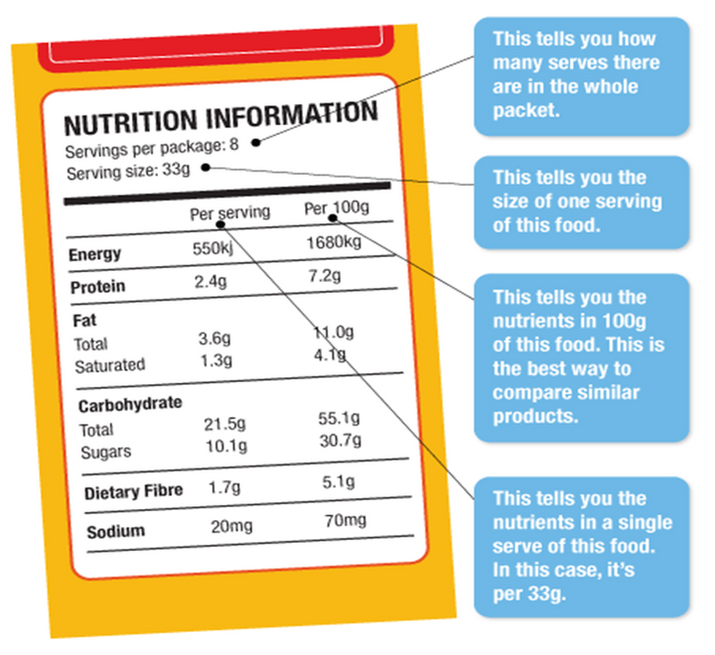
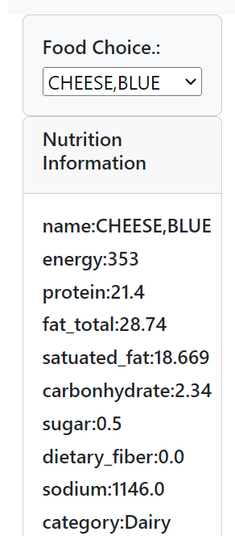
Example of generated food label

Slide 9

Brief Summary
Brief summary:
We are what we eat
One size does not fit all
Limitations
The dropdown menu could have been more user-friendly
Potential for future development
Some functions that allow users to design personal diets based on their needs/goals might be helpful

Slide 10
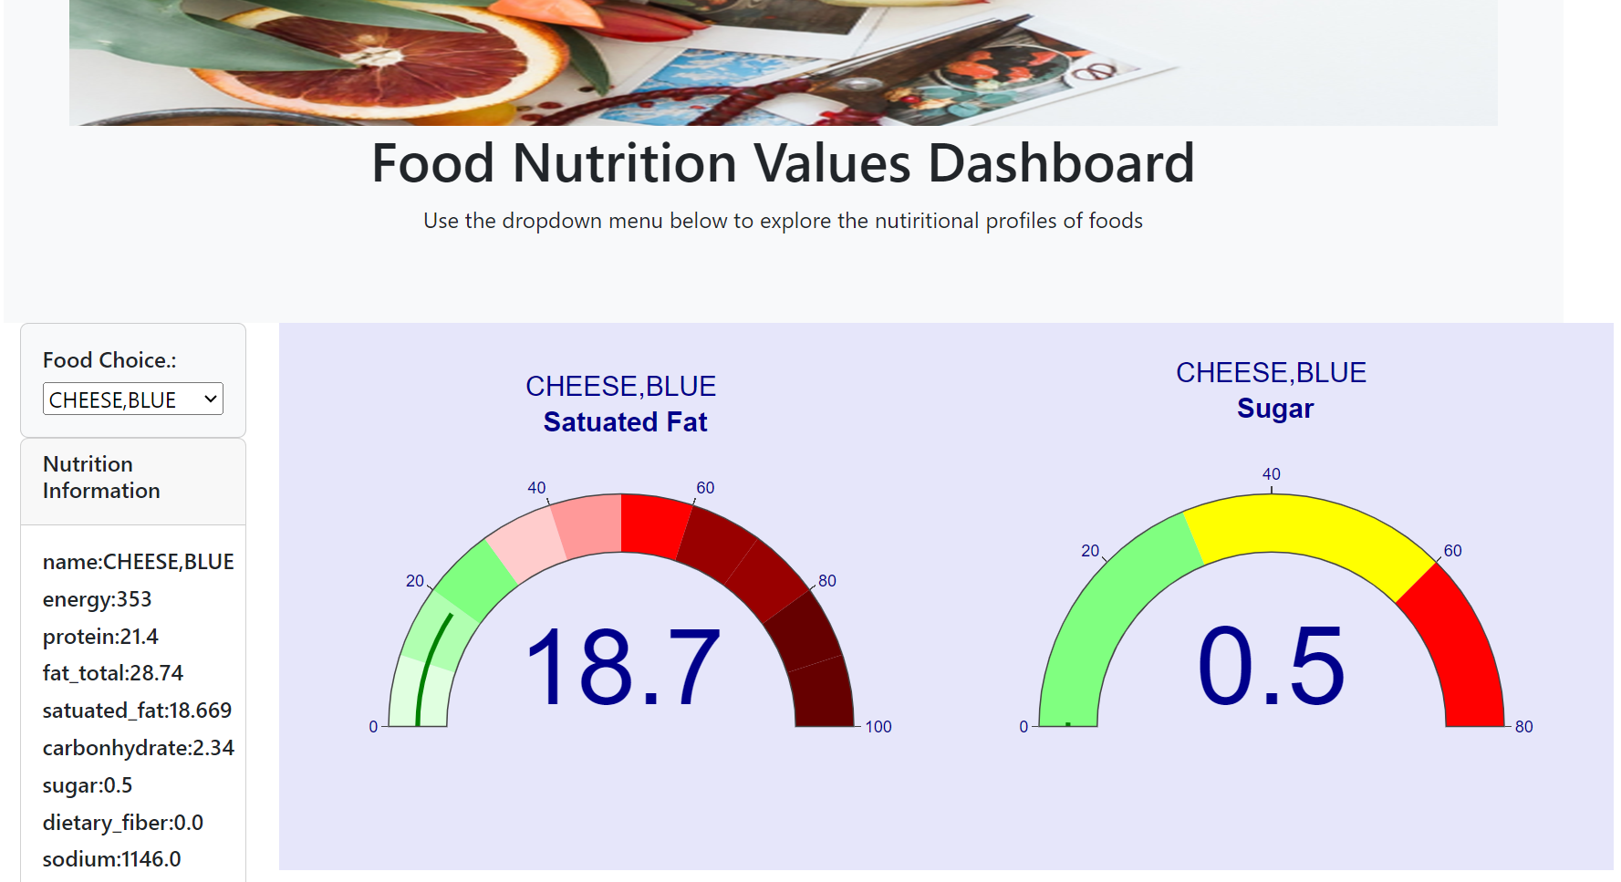

Slide 11
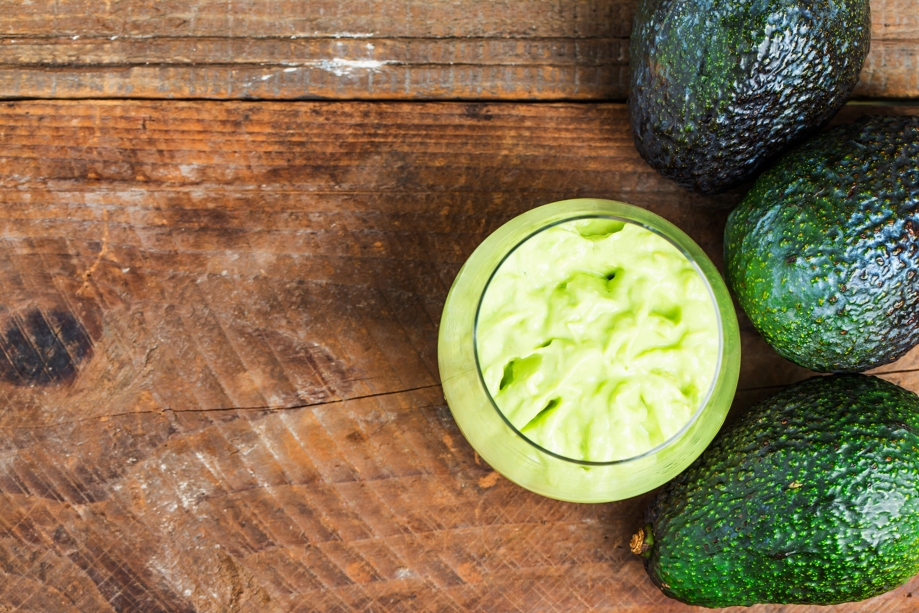
Q & A

Slide 12
THANK YOU!

